Slide 1


By –PRAGATI SHINDE

Slide 2
What is VLOOKUP()
EXAMPLE
IFERROR() With VLOOKUP
IFNA() With VLOOKUP
=VLOOKUP()

Slide 3
What is VLOOKUP
If we need to get the value of a column from some other file or sheet based on common column, you may use VLOOKUP. VLOOKUP is one of the most frequently used functions in Microsoft Excel and is predominantly used to GET data from other data sources corresponding to a particular key column in another data set.
VLookup also known as Vertical Lookup in Microsoft Excel.
IT Looks for a value in the leftmost column of a table, and then returns a value in the same row from column you specify.
By default, the table must be sorted in an ascending order.
Syntax:
=VLOOKUP(lookup_value, table_array, col_index_num, range_lookup)

Slide 4
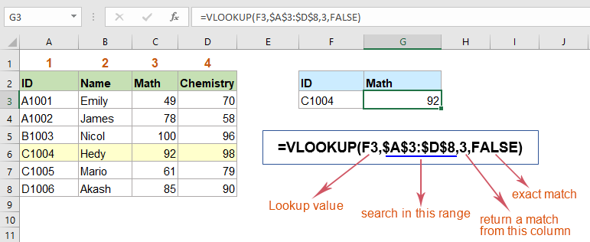
Example

Slide 5
Range _lookup value is False(0) -
Range _lookup value is True(1) -
False(0) for Exact match.
In exact match, if lookup value is not match with table then it gives NA(Not Available).
Syntax:
True(1) for Nearest match.
In nearest match, if lookup value is not match with table then it gives value to nearest match.
By default, range_lookup value is True.
Syntax:
= VLOOKUP (lookup_value, table_array, col_index_num, 0)
= VLOOKUP (lookup_value, table_array, col_index_num, 1)
= VLOOKUP (lookup_value, table_array, col_index_num)

Slide 6
IFERROR() With VLOOKUP
IFNA() With VLOOKUP
Return value_if_error if expression is an error and the value of the expression itself.
IFERROR() function handle any kind of error.
It has 2 arguments : value, value_if_error.
Syntax:
Return the value you specify if the expression resolver to #NA, otherwise returns the result of the expression.
IFNA() function handle only NA error.
It has 2 arguments : value, value_if_na.
Syntax:
= IFERROR(VLOOKUP (lookup_value, table_array, col_index_num, 0),”Not Found”)
= IFNA(VLOOKUP (lookup_value, table_array, col_index_num, 0),” -- ”)

Slide 7

Thank You

